Slide 1
Data Visualization Portfolio
Jochum, Michael D.
Here are some examples of some of my previous Data Visualizations

Slide 2
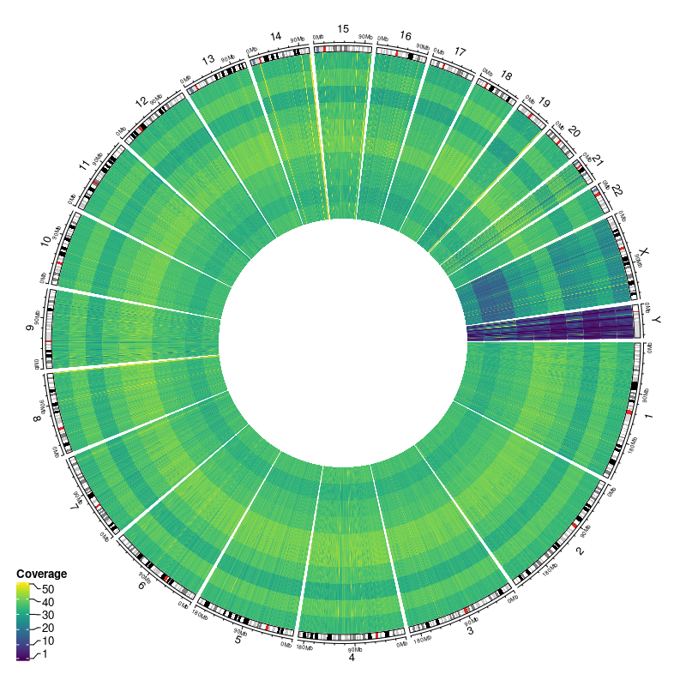
Circos Heatmap
Each ring in the circus plot represents the mean depth of coverage from 10 samples sequencing on the same run from the smith dataset Cohort 1 WGS starting with run 23409 on the outside and moving inward.
Mean Depth of Coverage Statistics
run | min | max | median | iqr | mean | sd | se | ci
23409 | 9.31 | 40.75 | 33.72 | 5.50 | 30.54 | 7.79 | 0.59 | 1.16
23453 | 27.06 | 41.62 | 34.47 | 3.80 | 33.88 | 2.95 | 0.22 | 0.44
23454 | 1.90 | 43.03 | 32.62 | 5.51 | 28.95 | 10.53 | 0.79 | 1.57
23457 | 15.43 | 44.88 | 35.30 | 5.65 | 33.33 | 6.26 | 0.47 | 0.93
23458 | 26.62 | 42.91 | 36.59 | 4.91 | 35.79 | 3.39 | 0.26 | 0.50
23459 | 28.63 | 45.23 | 37.02 | 4.45 | 36.35 | 3.25 | 0.25 | 0.48
23465 | 26.08 | 40.91 | 33.77 | 4.30 | 32.93 | 2.95 | 0.22 | 0.44
23487 | 18.25 | 41.25 | 33.65 | 5.58 | 32.34 | 4.66 | 0.35 | 0.69
23488 | 1.67 | 41.40 | 33.73 | 6.16 | 29.95 | 10.99 | 0.83 | 1.64
23862 | 0.01 | 45.42 | 37.42 | 6.68 | 32.90 | 12.91 | 0.97 | 1.92
Coverage statistics obtained from Samtools coverage reports
Mean depth of coverage

Slide 3
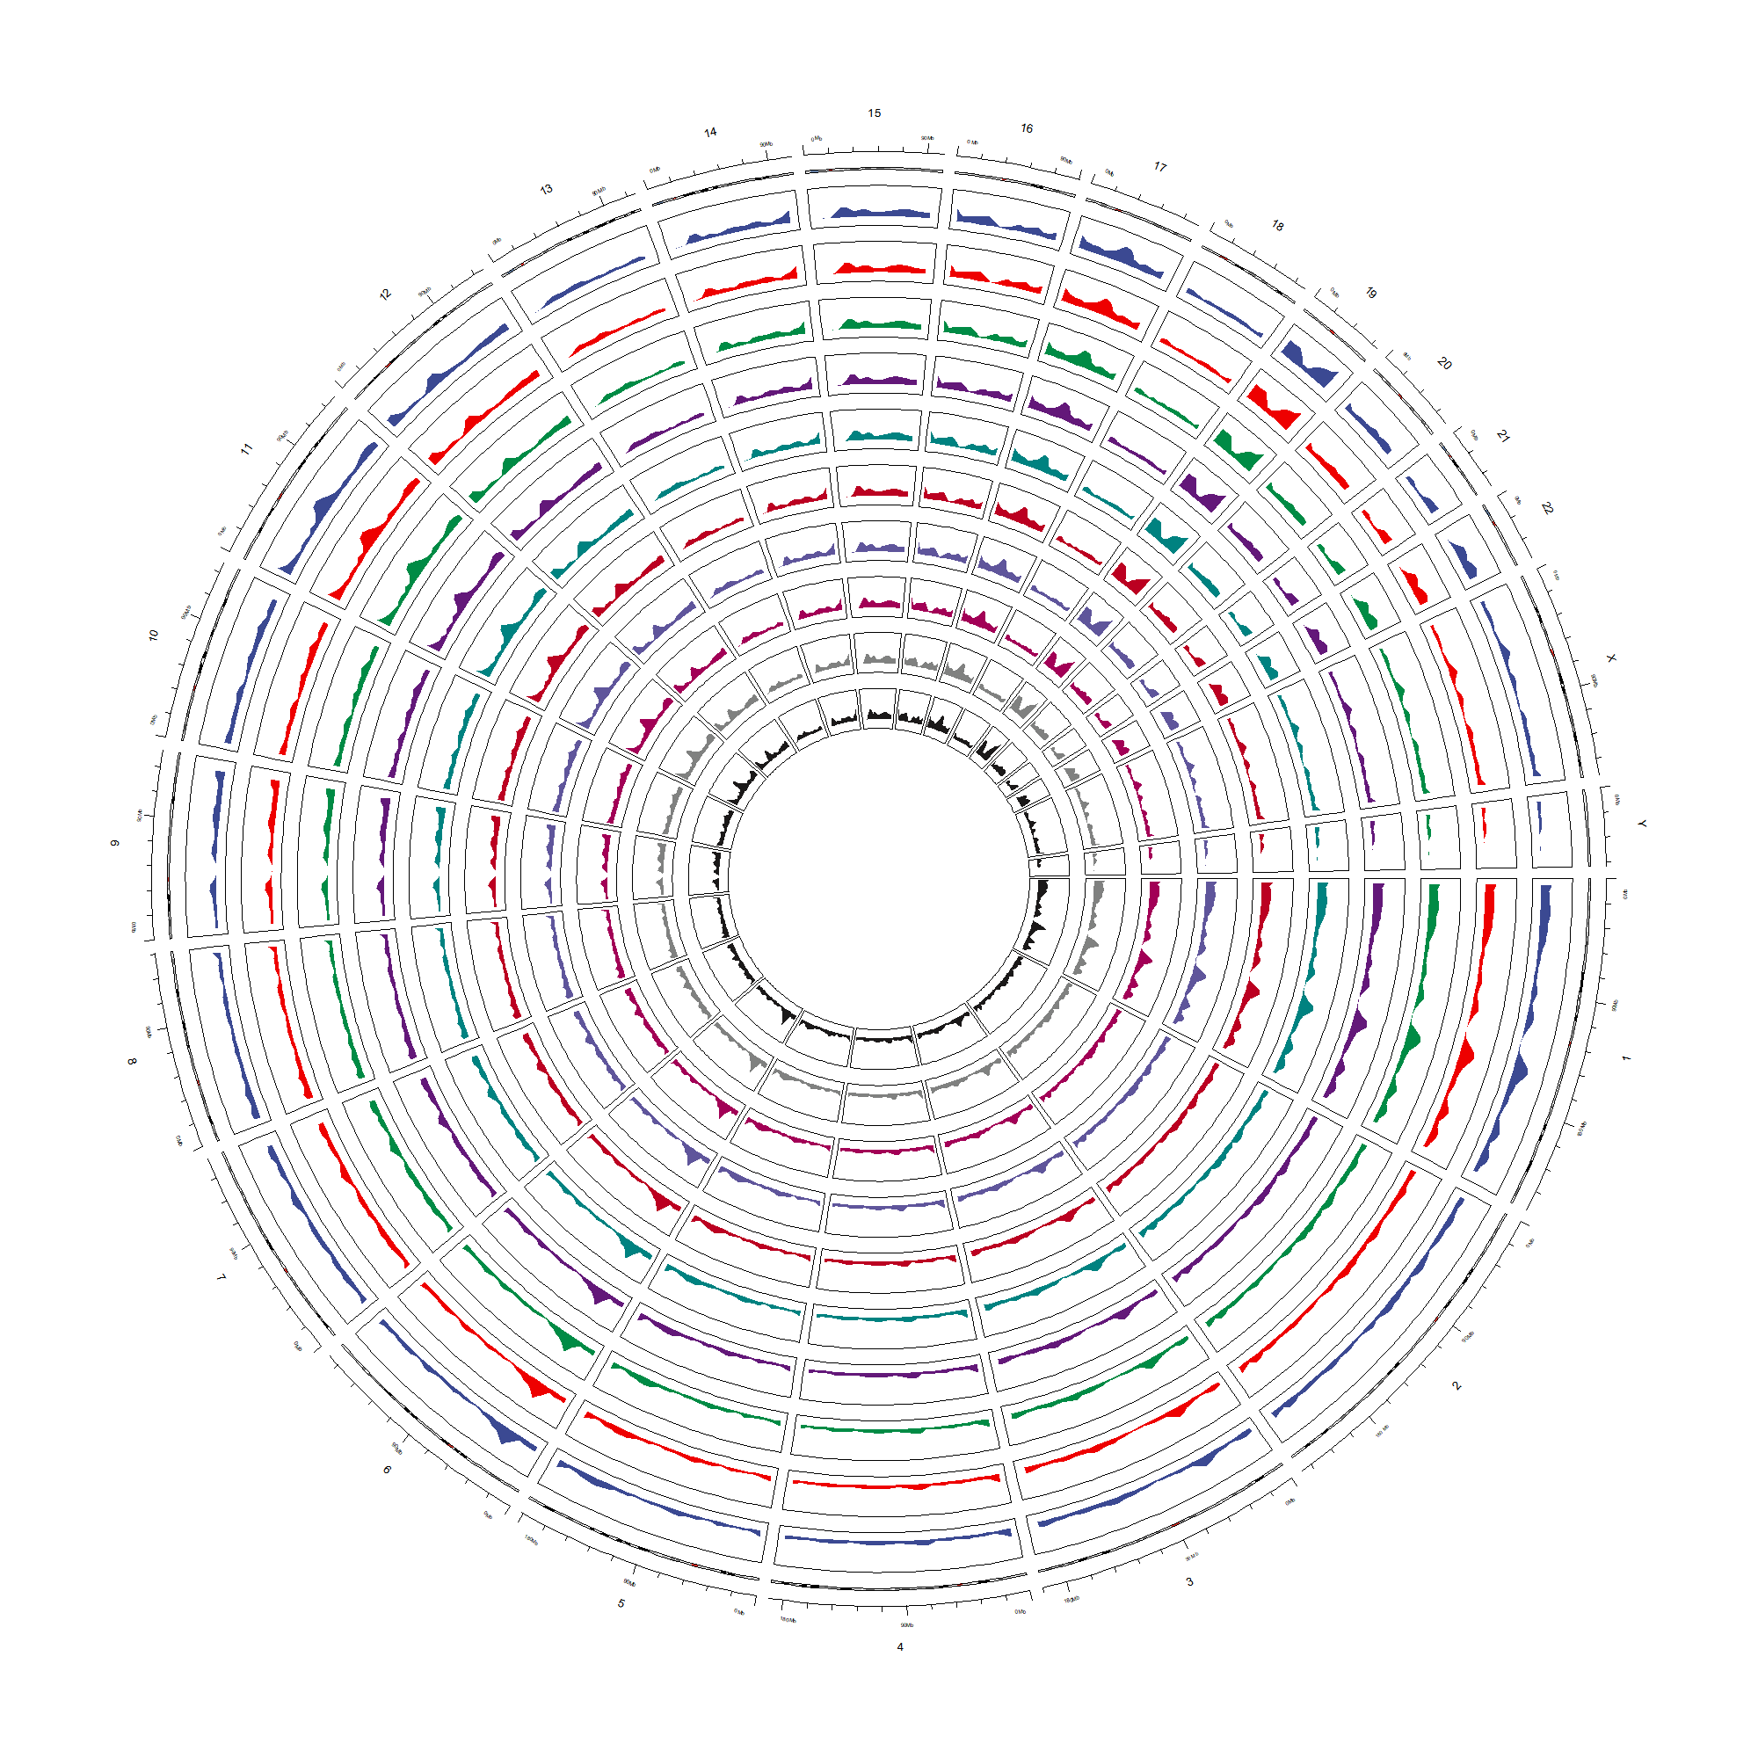
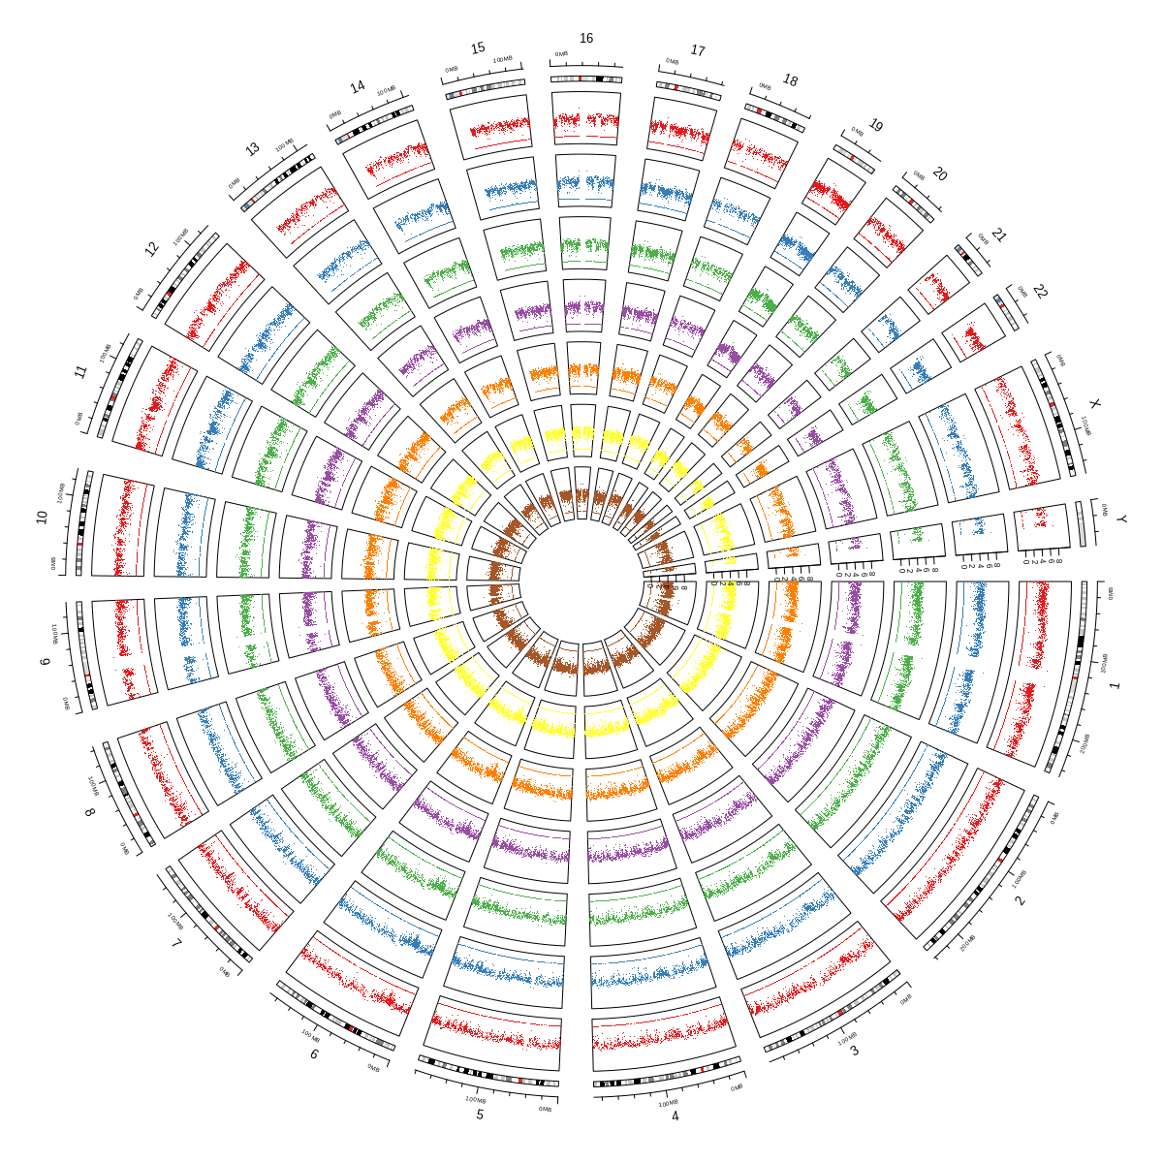
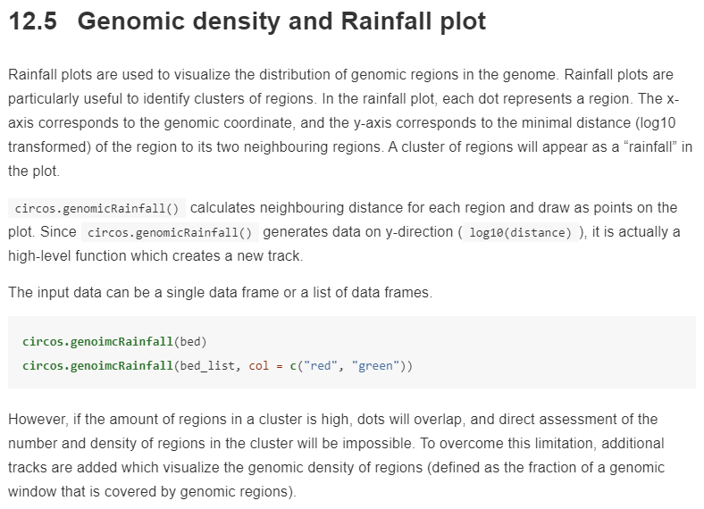
Cohort1 Genomic Density plot
Issue: automatically calculates how much a genomic window is covered by regions in bed. It is also a high-level function and creates a new track.
Cohort1 Genomic Rainfall Plot
Issue: The x-axis corresponds to the genomic coordinate, and the y-axis corresponds to the minimal distance (log10 transformed) of the region to its two neighbouring regions. A cluster of regions will appear as a “rainfall” in the plot

Slide 4
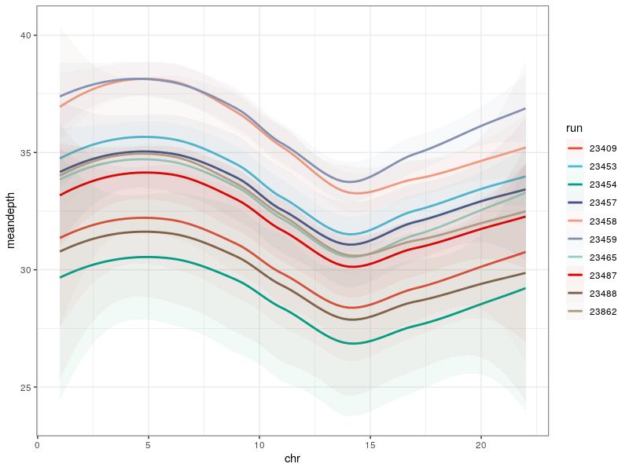
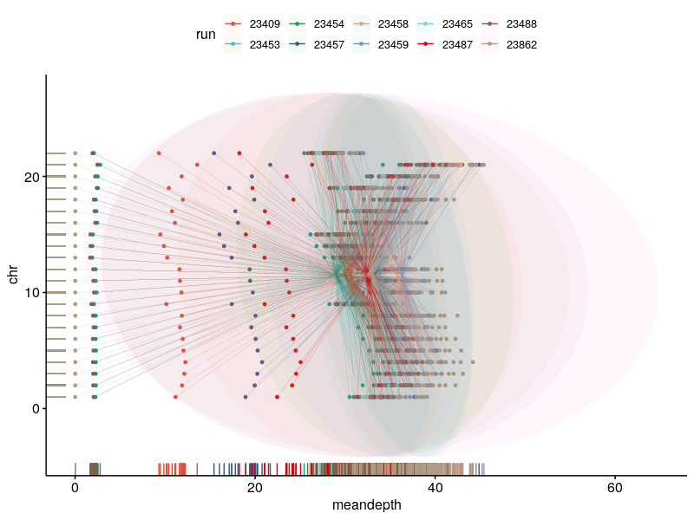
ggscatter(data = samcov, x = "meandepth", y = "chr", color = "run", size = 1, rug = T, conf.int = T, ellipse = T, ellipse.type = "norm", ellipse.alpha = 0.05, ellipse.border.remove = T, mean.point = F, star.plot = T, star.plot.lwd = 0.05)+ scale_color_npg()
ggplot(samcov,aes(x = chr,y = meandepth,color=run,fill=run, size=numreads2))+ geom_smooth(mapping = aes(x = chr,y = meandepth),method = "loess",alpha=0.05,se = T,)+ scale_color_npg()+ scale_fill_npg()+ theme_bw()

Slide 5
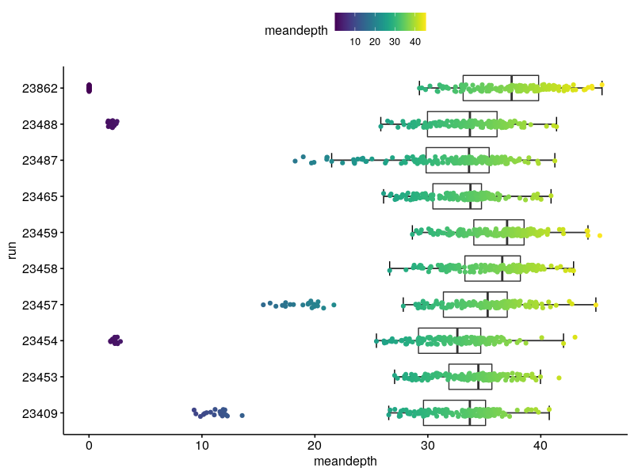
Mean Depth of Coverage Statistics
run | min | max | median | iqr | mean | sd | se | ci
23409 | 9.31 | 40.75 | 33.72 | 5.50 | 30.54 | 7.79 | 0.59 | 1.16
23453 | 27.06 | 41.62 | 34.47 | 3.80 | 33.88 | 2.95 | 0.22 | 0.44
23454 | 1.90 | 43.03 | 32.62 | 5.51 | 28.95 | 10.53 | 0.79 | 1.57
23457 | 15.43 | 44.88 | 35.30 | 5.65 | 33.33 | 6.26 | 0.47 | 0.93
23458 | 26.62 | 42.91 | 36.59 | 4.91 | 35.79 | 3.39 | 0.26 | 0.50
23459 | 28.63 | 45.23 | 37.02 | 4.45 | 36.35 | 3.25 | 0.25 | 0.48
23465 | 26.08 | 40.91 | 33.77 | 4.30 | 32.93 | 2.95 | 0.22 | 0.44
23487 | 18.25 | 41.25 | 33.65 | 5.58 | 32.34 | 4.66 | 0.35 | 0.69
23488 | 1.67 | 41.40 | 33.73 | 6.16 | 29.95 | 10.99 | 0.83 | 1.64
23862 | 0.01 | 45.42 | 37.42 | 6.68 | 32.90 | 12.91 | 0.97 | 1.92

Slide 6
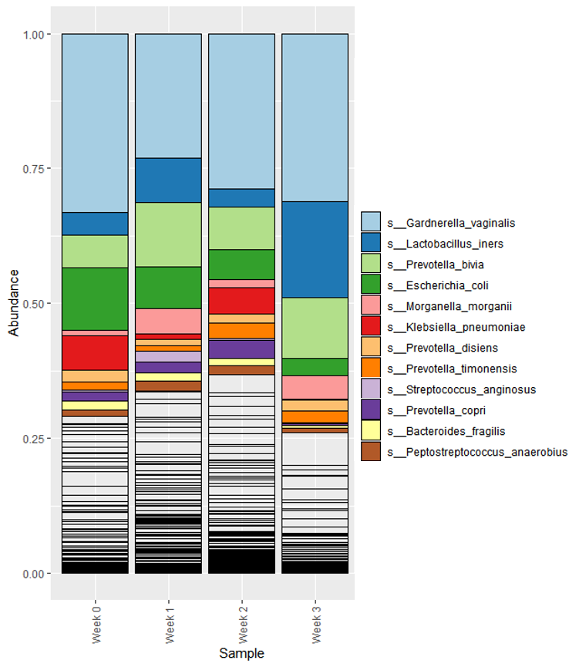
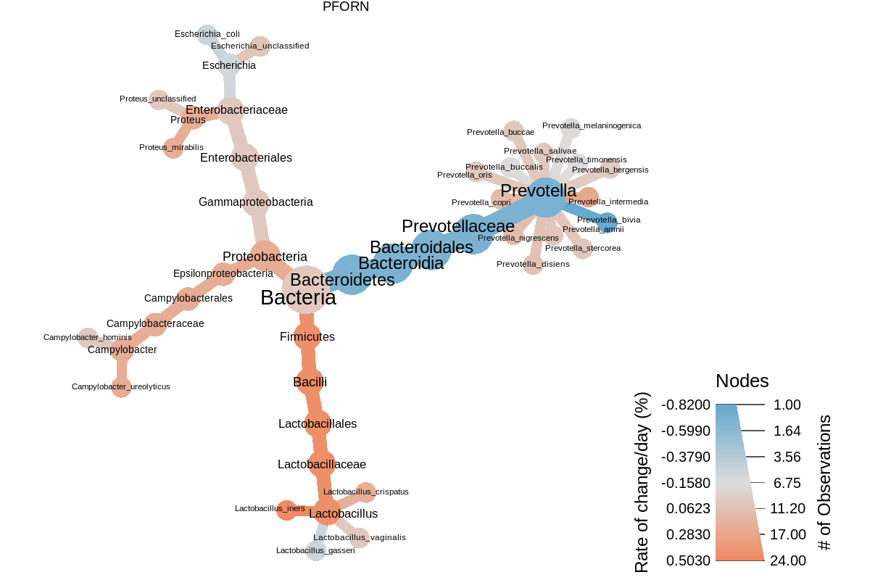
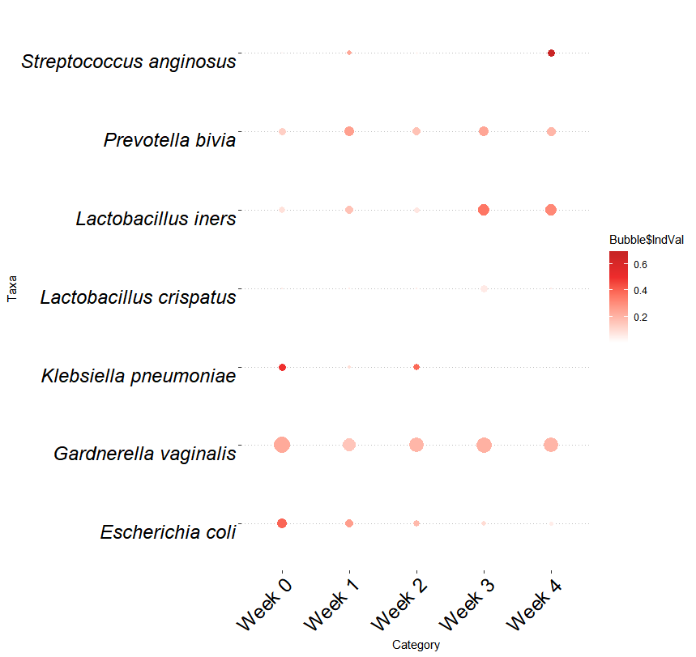
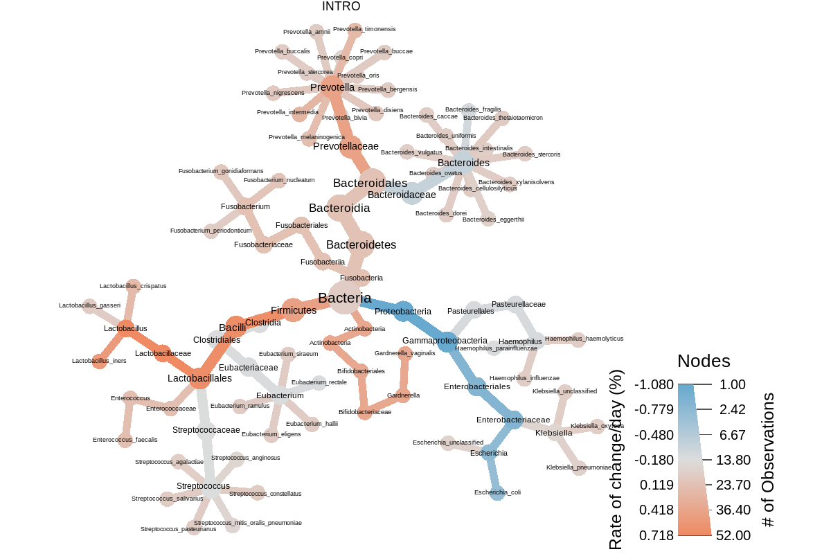
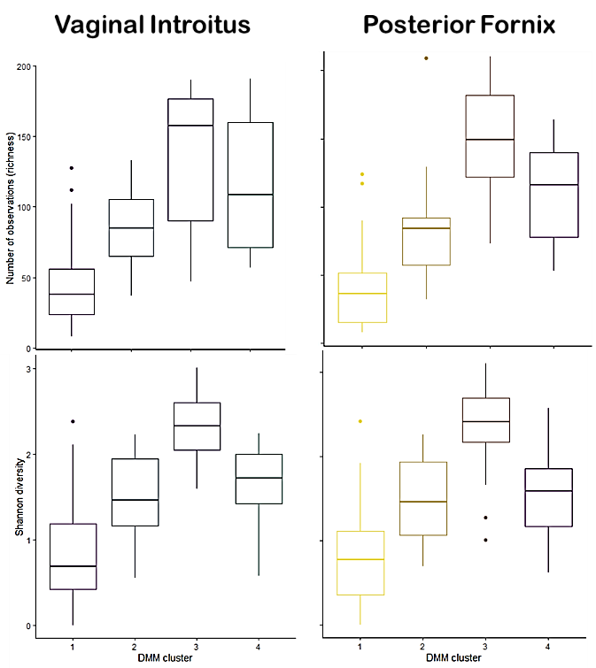
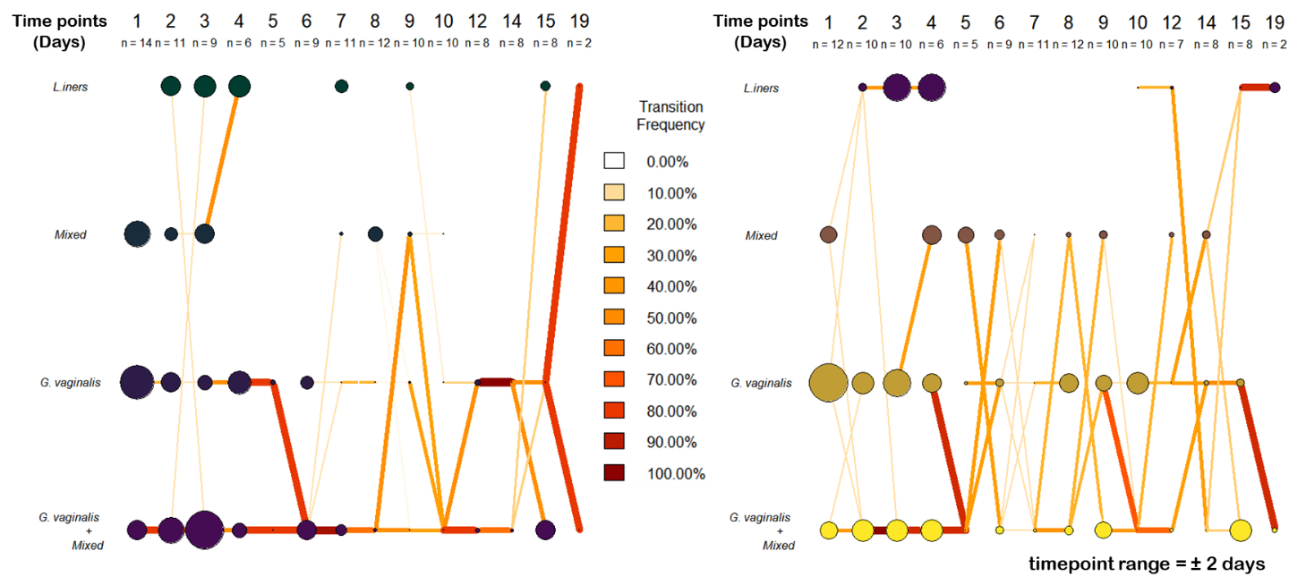
Relative abundance
D)
B)
A)
C)
E)
Week 0
Week 1
Week 2
Week 3
Figure 1. A) Stacked and B) bubble bar charts of top vaginal species averaged by week (min. prevalence & detection = 5%). C) Alpha diversity boxplot comparisons of richness(top) and Shannon diversity indices (bottom) per DMM cluster in vaginal introitus (left) and posterior fornix (right) samples. D) Heat tree taxonomic comparisons of taxa with > 0.1% ∆ day⁻¹ post-operative fistula repair in vaginal introitus (left) & posterior fornix (right). E) DMM cluster transition model showing vaginal introitus (left) & posterior fornix (right) microbiome progressions from Day 1-21 post-op.

Slide 7
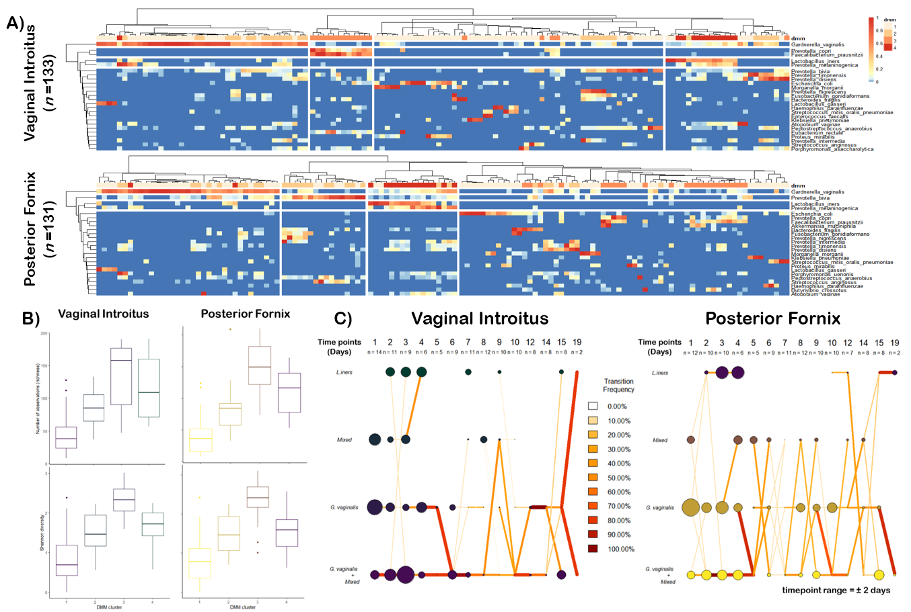
Figure 2. DMM clustering of vaginal shotgun gene sequencing data (n=264). A. Heat map showing Ward clustering of the relative abundance of the most dominant bacterial species per DMM cluster B. Box plots showing richness and Shannon alpha diversity indices per each DMM cluster (centerline= median, Boxes = 25th and 75th percentiles, whiskers= most distant data point less than 1.5x the box length, with outliers represented byt points outside the whiskers) C. Transition model showing the progression of vaginal samples through each DMM cluster per each time point from Day 1 to 21 post-operative repair.

Slide 8
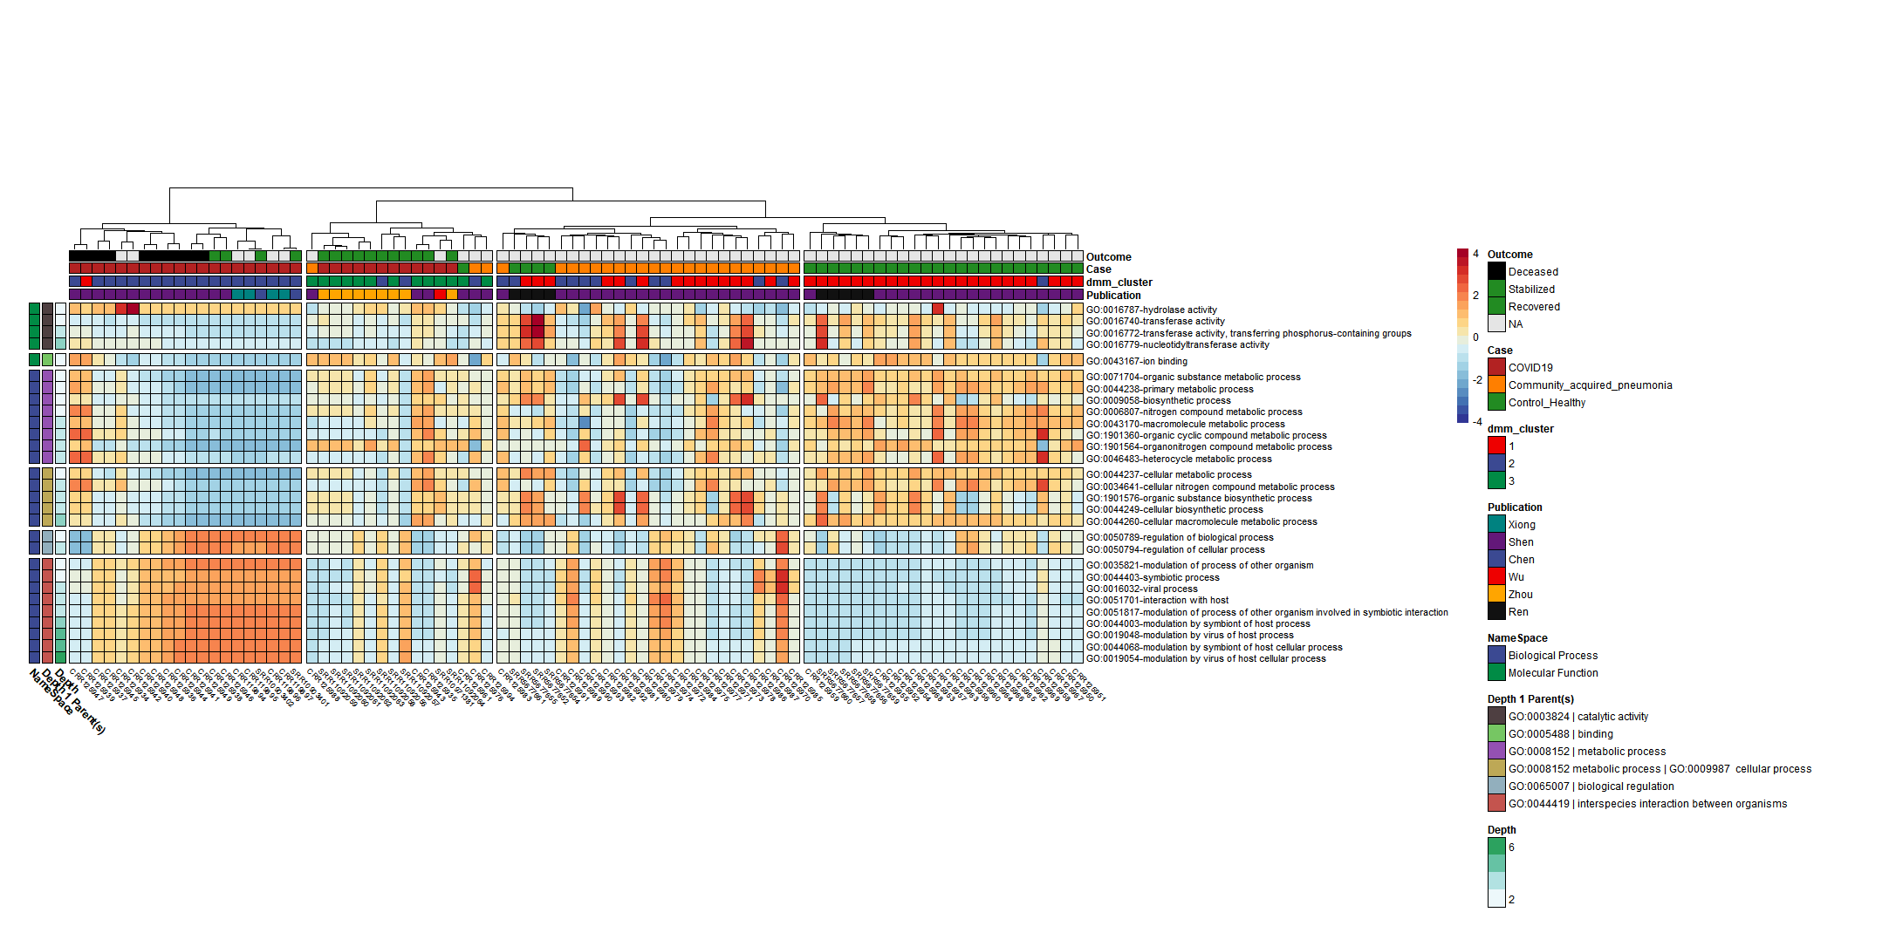
COVID19 vs Uninfected & viral pneumonia
Uninfected
Notes:
Significant Terms of interest associated with COVID19 include hydrolase/transferase activity transferring phosphorus, and nucleotidyltransferase activity, and ion binding.
Additionally, Results from the Dirichlet Multinomial Mixtures clustering analysis using all 13,534 Gene ontologies counts resulted in a best model fit using 3 distinct dmm clusters that were significantly associated with each case type p<0.0001***.
Figure 1. Microbially derived gene ontology functional annotations associated with COVID19. Comparisons were conducted using Maaslin2, controlling for publication and patient with Benjamini Hochber multiple test comparison (q<0.05)

Slide 9

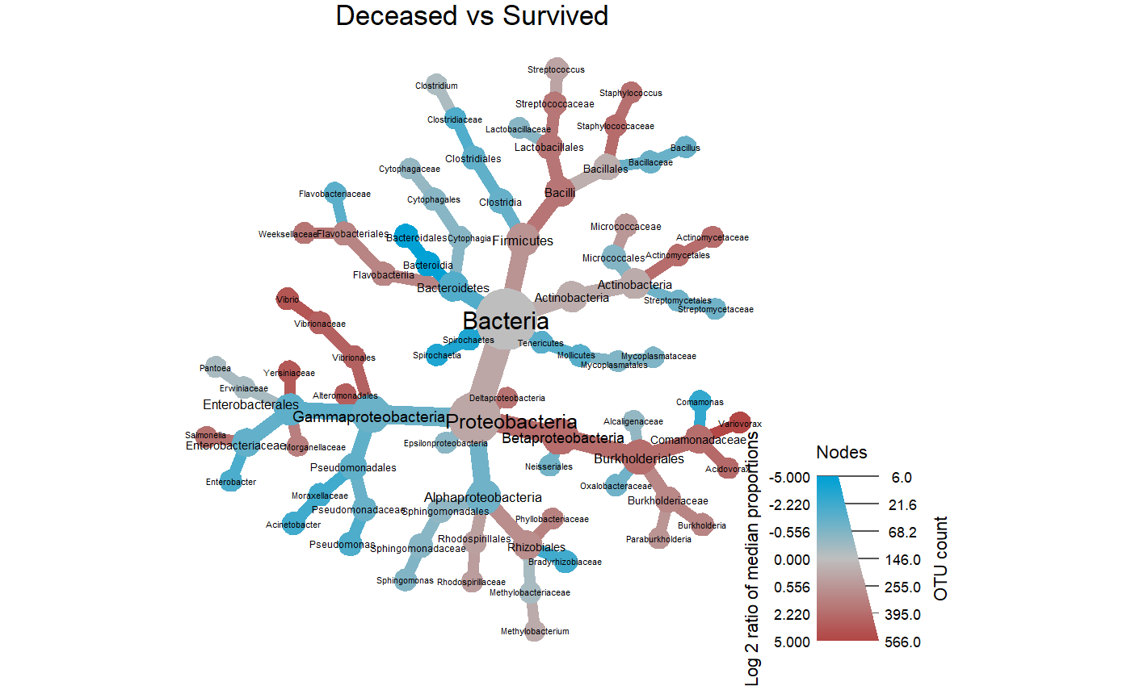
COVID-19 Mortality Taxonomic profiles
Taxonomic comparisons (Deceased vs Survived)
log₂ median ratio | Median diff | Mean diff | p value | q value | Taxonomy
2.25 | 0.361 | 0.371 | 0.00017 | 0.00691 | Comamonadaceae
5.21 | 0.405 | 0.377 | 0.00017 | 0.00691 | Variovorax
2.97 | 0.002 | 0.002 | 0.00353 | 0.074 | Vibrionales
2.97 | 0.002 | 0.002 | 0.00353 | 0.074 | Vibrionaceae
3.8 | 0.002 | 0.00181 | 0.00492 | 0.0827 | Vibrio
1.84 | 0.0549 | 0.13 | 0.0137 | 0.124 | Bacilli
2.24 | 0.403 | 0.297 | 0.0163 | 0.124 | Burkholderiales
3.16 | 0.002 | 0.002 | 0.0157 | 0.124 | Alteromonadales
3.61 | 0.004 | 0.004 | 0.0156 | 0.124 | Yersiniaceae
2.1 | 0.005 | 0.00435 | 0.0156 | 0.124 | Salmonella
1.77 | 0.011 | 0.064 | 0.0475 | 0.274 | Streptococcaceae
2.29 | 0.425 | 0.296 | 0.0264 | 0.185 | Betaproteobacteria
-5.13 | -0.103 | -0.104 | 0.0308 | 0.199 | Bacteroidia
-5.18 | -0.099 | -0.102 | 0.00962 | 0.124 | Bacteroidales
log₂ median ratio | Median diff | Mean diff | p value | q value | Taxonomy
2.25 | 0.361 | 0.371 | 0.00017 | 0.00691 | Comamonadaceae
5.21 | 0.405 | 0.377 | 0.00017 | 0.00691 | Variovorax
2.97 | 0.002 | 0.002 | 0.00353 | 0.074 | Vibrionales
2.97 | 0.002 | 0.002 | 0.00353 | 0.074 | Vibrionaceae
3.8 | 0.002 | 0.00181 | 0.00492 | 0.0827 | Vibrio
1.84 | 0.0549 | 0.13 | 0.0137 | 0.124 | Bacilli
2.24 | 0.403 | 0.297 | 0.0163 | 0.124 | Burkholderiales
3.16 | 0.002 | 0.002 | 0.0157 | 0.124 | Alteromonadales
3.61 | 0.004 | 0.004 | 0.0156 | 0.124 | Yersiniaceae
2.1 | 0.005 | 0.00435 | 0.0156 | 0.124 | Salmonella
1.77 | 0.011 | 0.064 | 0.0475 | 0.274 | Streptococcaceae
2.29 | 0.425 | 0.296 | 0.0264 | 0.185 | Betaproteobacteria
-5.13 | -0.103 | -0.104 | 0.0308 | 0.199 | Bacteroidia
-5.18 | -0.099 | -0.102 | 0.00962 | 0.124 | Bacteroidales
log₂ median ratio | Median diff | Mean diff | p value | q value | Taxonomy
2.25 | 0.361 | 0.371 | 0.00017 | 0.00691 | Comamonadaceae
5.21 | 0.405 | 0.377 | 0.00017 | 0.00691 | Variovorax
2.97 | 0.002 | 0.002 | 0.00353 | 0.074 | Vibrionales
2.97 | 0.002 | 0.002 | 0.00353 | 0.074 | Vibrionaceae
3.8 | 0.002 | 0.00181 | 0.00492 | 0.0827 | Vibrio
1.84 | 0.0549 | 0.13 | 0.0137 | 0.124 | Bacilli
2.24 | 0.403 | 0.297 | 0.0163 | 0.124 | Burkholderiales
3.16 | 0.002 | 0.002 | 0.0157 | 0.124 | Alteromonadales
3.61 | 0.004 | 0.004 | 0.0156 | 0.124 | Yersiniaceae
2.1 | 0.005 | 0.00435 | 0.0156 | 0.124 | Salmonella
1.77 | 0.011 | 0.064 | 0.0475 | 0.274 | Streptococcaceae
2.29 | 0.425 | 0.296 | 0.0264 | 0.185 | Betaproteobacteria
-5.13 | -0.103 | -0.104 | 0.0308 | 0.199 | Bacteroidia
-5.18 | -0.099 | -0.102 | 0.00962 | 0.124 | Bacteroidales
Log2 ratio of median proportions
Read Count
Comparisons were conducted using Wilcoxon rank sum test and adjusted for multiple test comparisons using the benajmini hochberg correction method
Notes:
Survivors of COVID19 moderate to severe disease had a significantly unique BALF metatransciptome profile with notable decreases in the log2 median ratios in the *** Family Comamonadaceae genus Variovorax and
Additionally, thee wer significant increases in the log2 median ratios of order Bacteroidia and class Bacteroidales
https://www.medrxiv.org/content/10.1101/2020.08.20.20144014v1.full.pdf
Notably, Variovorax account for a very high proportion in 6 patients. Interestingly, Staphylococcus xylosus and
https://www.nature.com/articles/s42003-021-01796-w
Staphylococcus simulans had high abundances in three healthy controls (H21, H22 and H23)

Slide 10
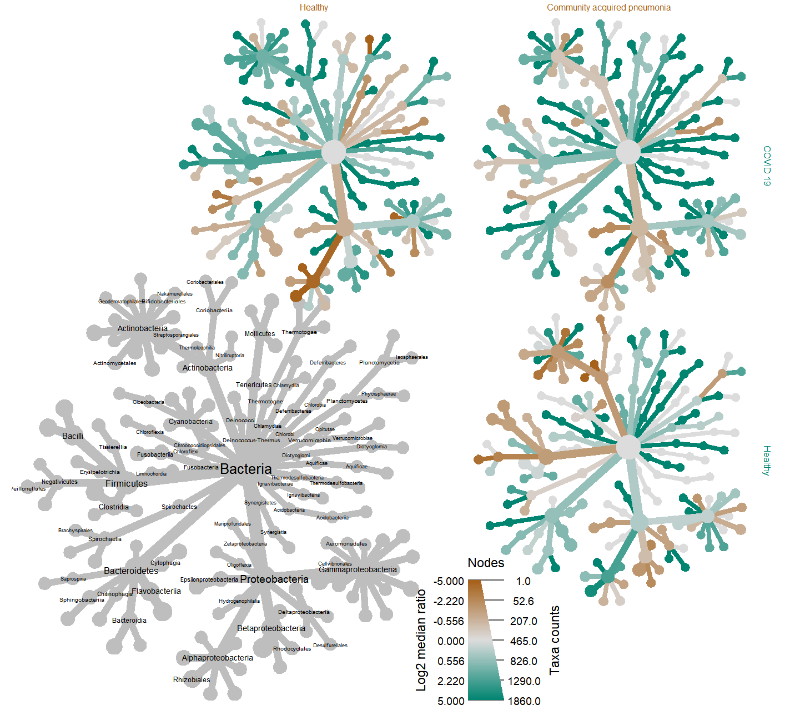
COVID19 vs Uninfected & viral pneumonia
Differential Taxonomic abundances
Community acquired pneumonia
Uninfected
Sphingomonas
treatment | median ratio | p | q
CAP | -2.05 | 0.007 | <0.05 | *
Uninfected | -2.80 | <0.0001 | <0.0005 | ***
COVID19
Uninfected
Notes:
Taxonomic analysis revealed a statistically significant decrease in log2 median ration of several species *** belonging to the genus Sphingomonas when compared to both the uninfected (p<0.0001, q <0.001) and CAP cohorts (p<0.005,q <0.05) cohorts (table X). This finding supports previous reports regarding an association with Sphingomonas, which is commonly known as an opportunistic pathogen found in healthcare-associated pneumonia.
Sig. GO Terms derived from Sphingomonas proteins in the COVID19 samples were
hydrogen peroxide catabolic process [GO:0042744];
response to oxidative stress [GO:0006979]
catalase activity [GO:0004096]; heme binding [GO:0020037];
metal ion binding [GO:0046872]
The catalase protein decomposes hydrogen peroxide into water and oxygen; serves to protect cells from the toxic effects of hydrogen peroxide.
So as a discussion point perhaps Sphingomonas is responding to COVID-19 conditions in the patient by expressing genes that help it to survive well under the COVID-19 disease conditions.

Slide 11
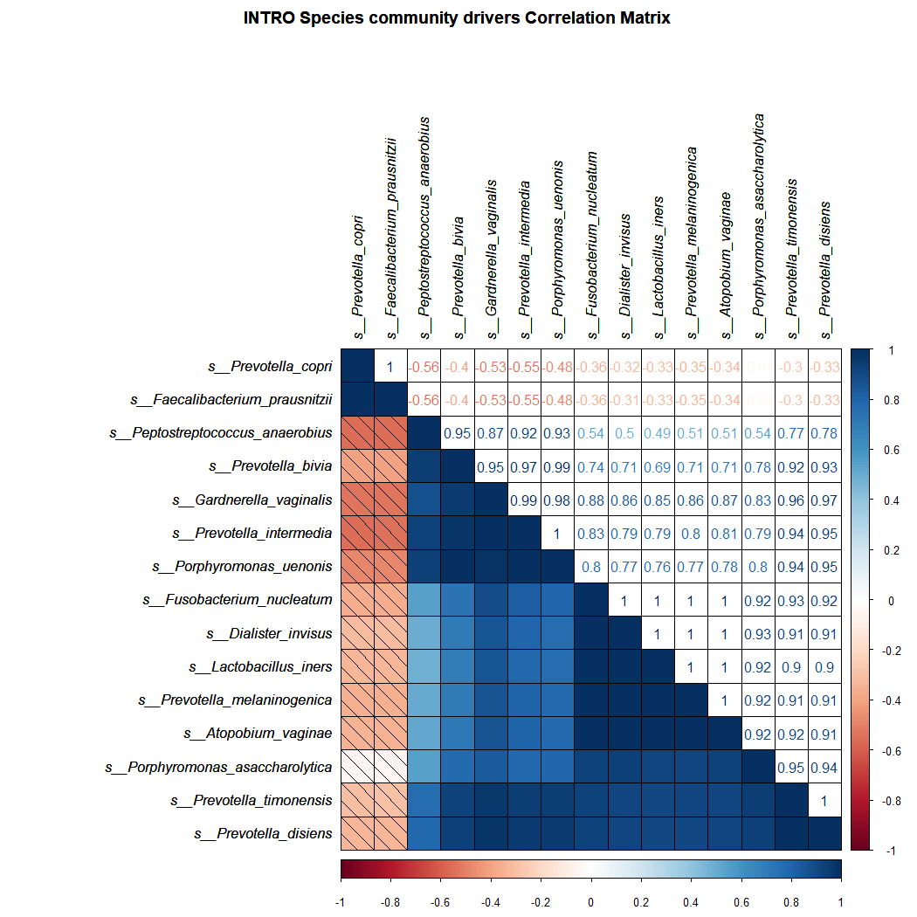
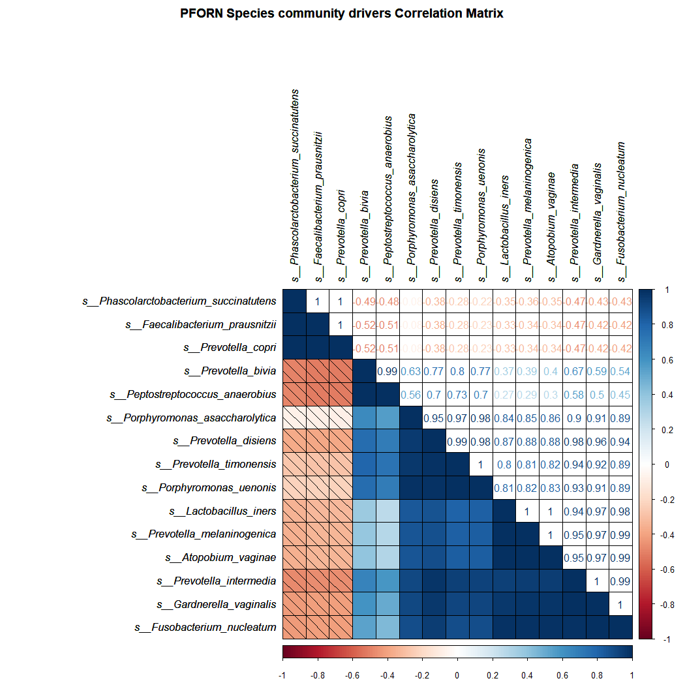

Slide 12
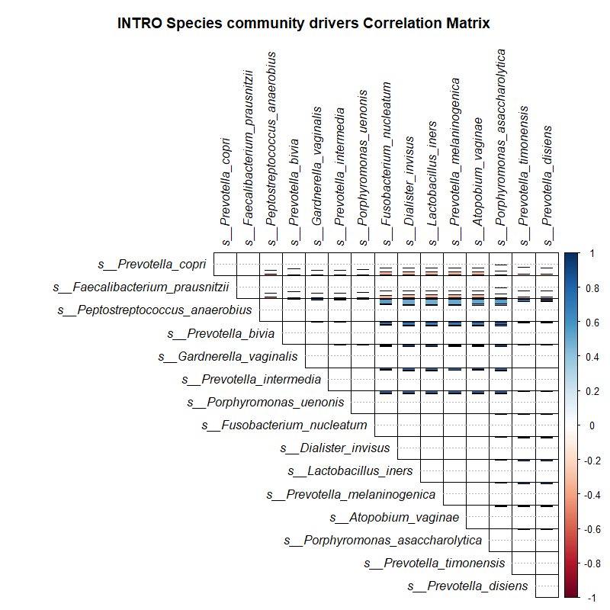
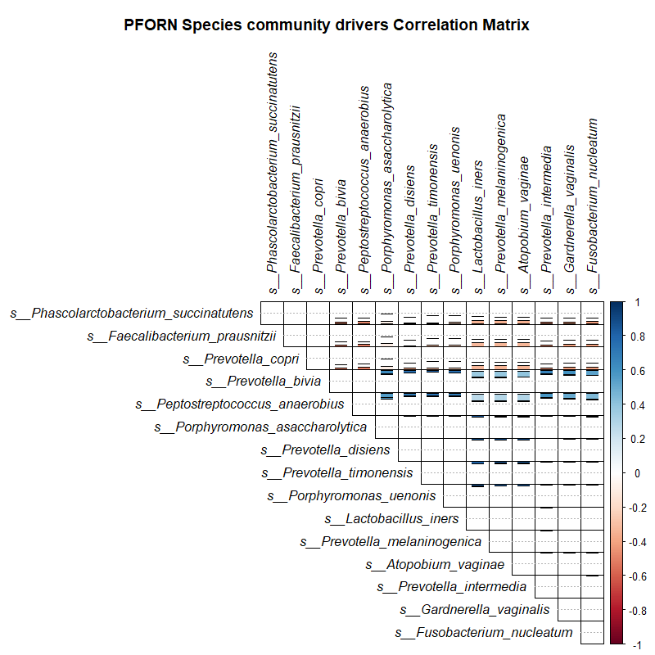

Slide 13
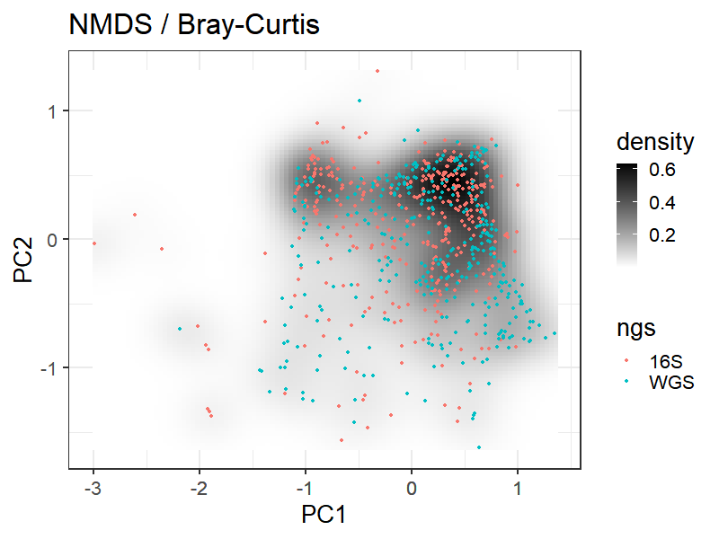
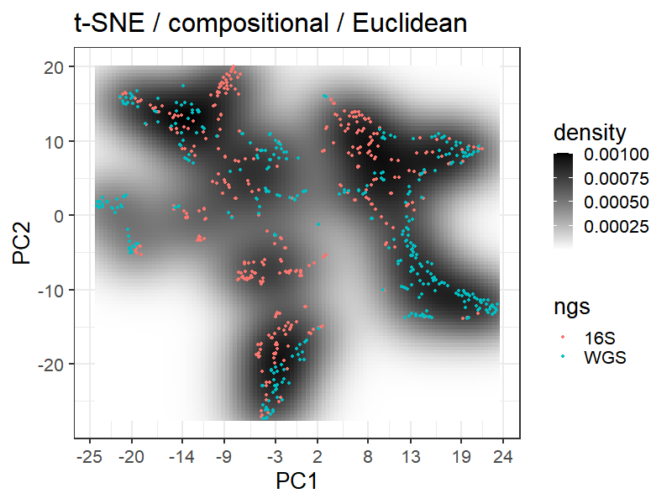
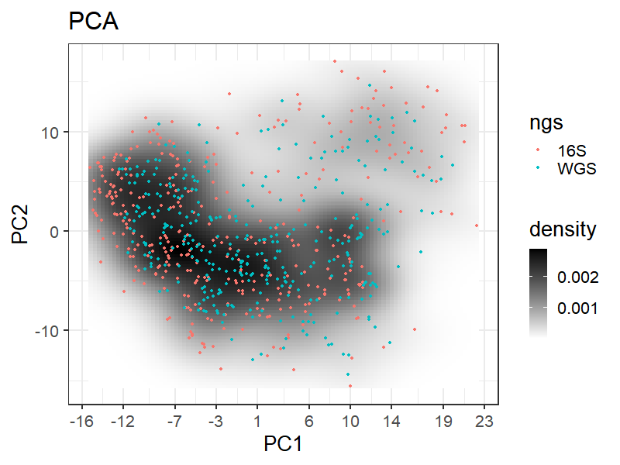
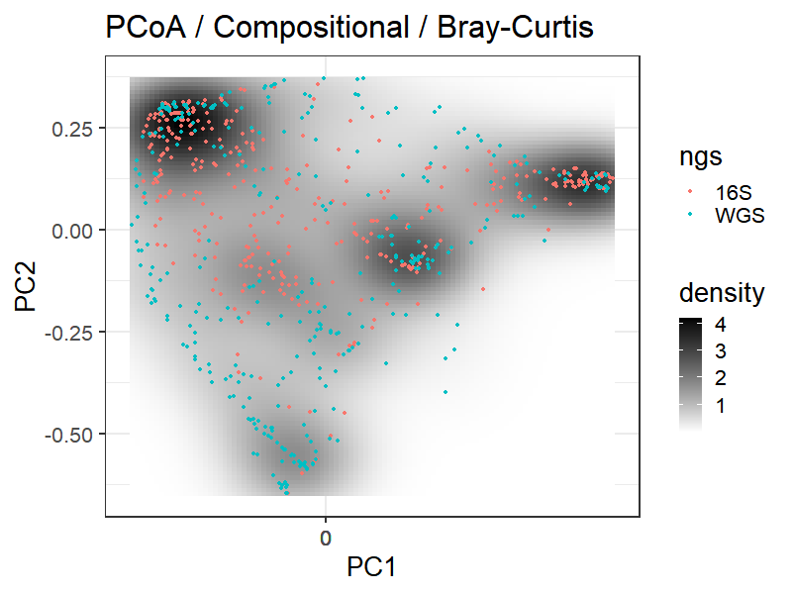
Notes:
Fig. S7. Ordination plot comparisons of 16S and WGS analysis results of microbial communities using Bray Curtis distance matrix indices.

Slide 14
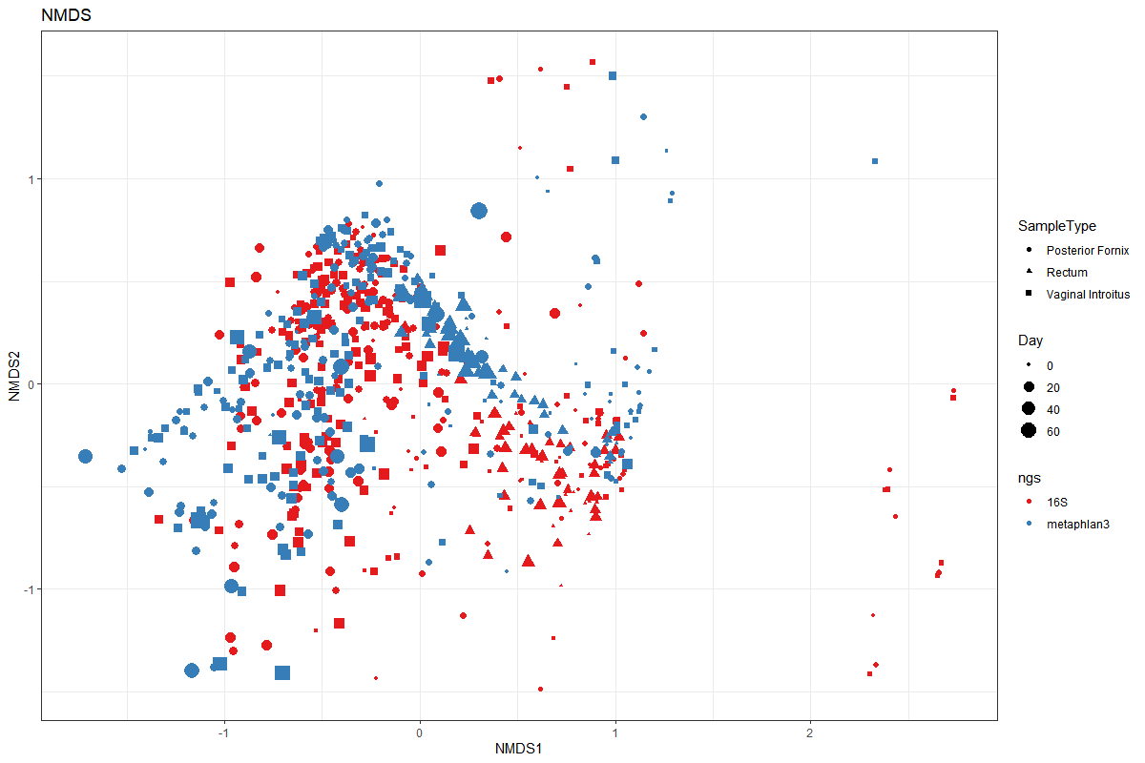

Slide 15

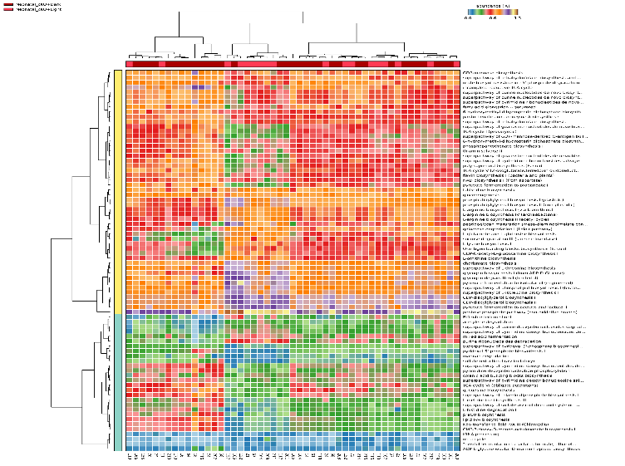
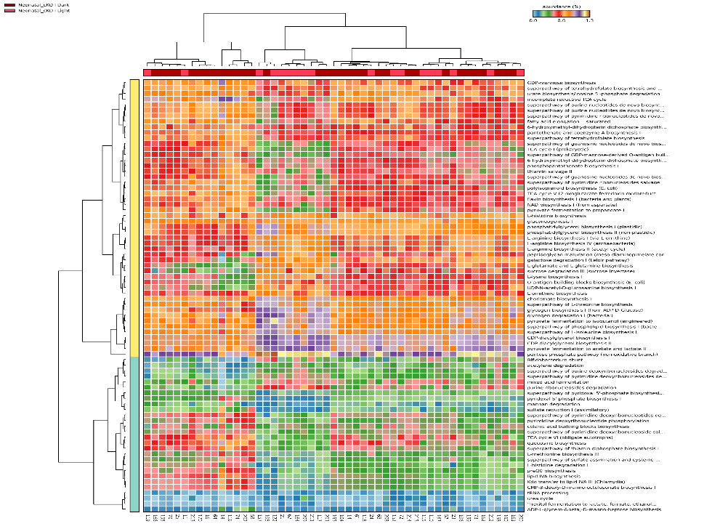
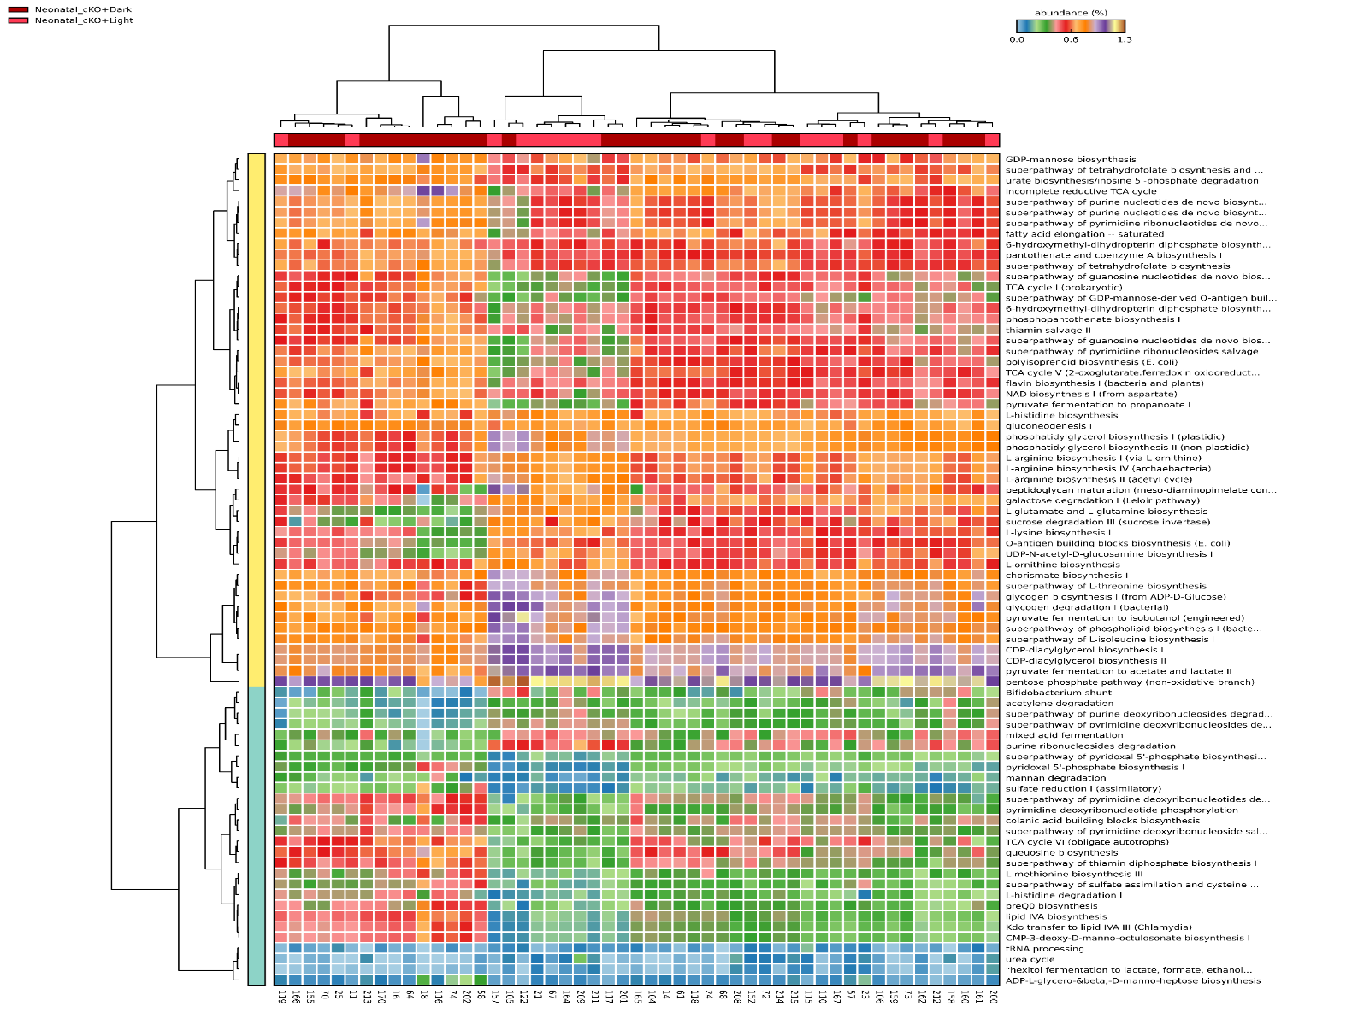
Study Design and Microbiome Pipeline
Sample Collection
Generate Npas2 fetal and neonatal cKO mice, with accompanying WT controls
stool sample collection 16-week post-weening time trials
11am
Start
3pm
7pm
11pm
3am
7am
11am
End
Stool Sampling
Next Gen Sequencing
DNA extraction
16S PCR amplification
Illumina NGS sequencing
Pre-processing
Trimmomatic
Multi/FastQC
DADA2
DNA Extract/PCR
Denoising
Dereplication
ASV processing
PE merging
Chimera removal
Read classification
RDP kmer classification (R environment)
Silva_132 database
V1
V2
V3
V4
V5
V6
V7
V8
V9
Decontamination
Library decontam (R environment)
PCoA
AGTCTCAGATACGACCAGATG
TCGATCAGATAGC--CAGCCG
GCGGGCAGATACGTTCAGTAT
Microbiome Analysis
Analysis
Phyloseq
Vegan
STAMP
Relative Abundance
Functional Microbiome Analysis (PICRUST2)
Align ASVs to reference sequences (HMMER)
Build a reference tree (EPA-NG)
16S copy number normalization (castor)
Determine gene family abundance
Infer functional pathway abundance (MiniPath)
QA/QC (NTSI and CI scoring)
Statistical Analyses
ANOVA with Posthoc Tukey-Kramer (multiple)
Welch’s T test (2-way) w/ 95% Confidence Intervals
Functional Analysis
Data Visualization
Phyloseq
ggplot2
STAMP
Notes:
The experiment began with the generation of neonatal and fetal NPAS2 cKO mice with accompanying wild type controls to 16 weeks post-weening,*** followed by stool samples collection at 4-hour increments over 12:12 hr light /dark cycles.*** Samples were DNA extracted and PCR amplified using the V4 16S rRNA gene, and Next gen sequenced using the Illumina platform*** Reads were adapter trimmed and Qced, processed into amplicon sequence variants (ASVs)***,classified into taxa***, and decontaminated.*** Taxonomic comparisons, and diversity indices were obtained, and *** Predicted functional abundances were obtained using the ASV marker gene sequences, and QCed to a Nearest sequence taxon index of greater than 2.*** Statistical analyses consisted of an Analysis of variance with Posthoc Tukey-Kramer for multiple comparisons or Welch’s T test with 95% confidence intervals for 2-way comparisons, *** followed by the creation of Data visualizations.

Slide 16
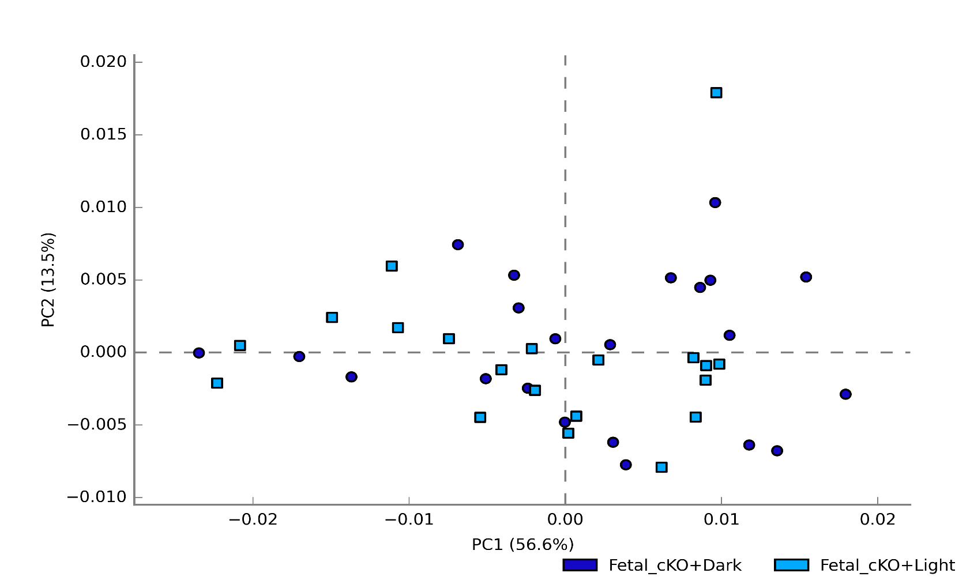
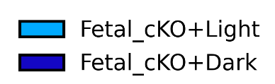
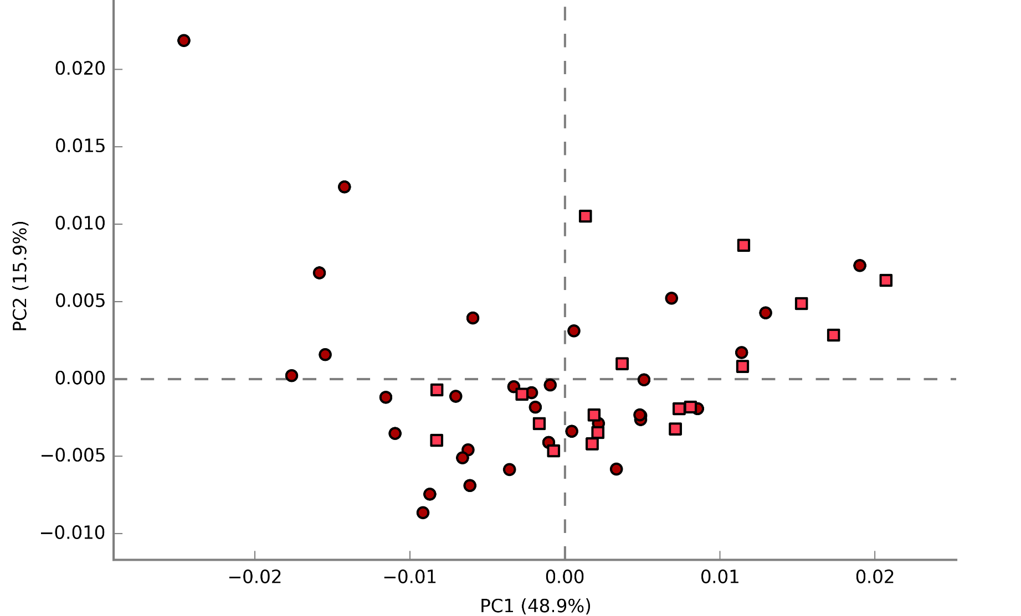
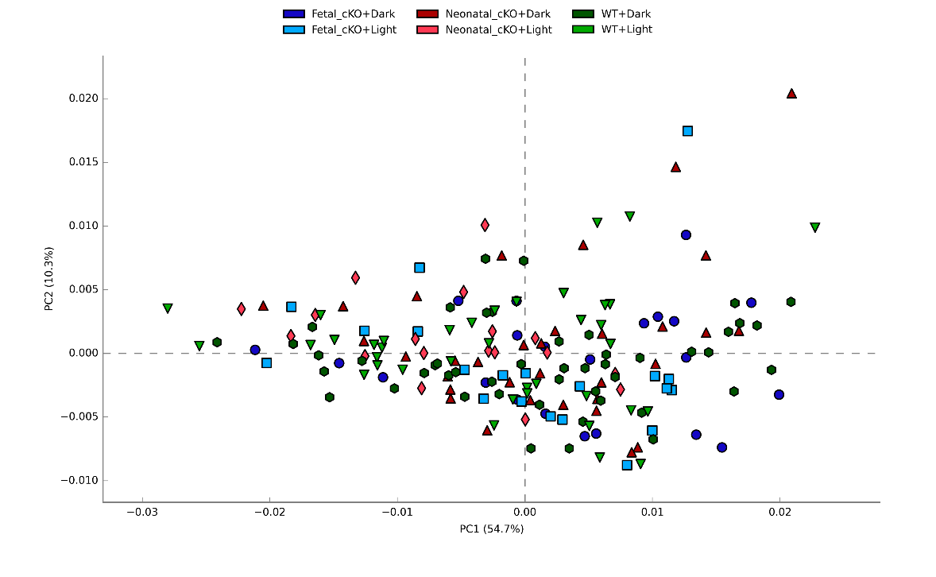
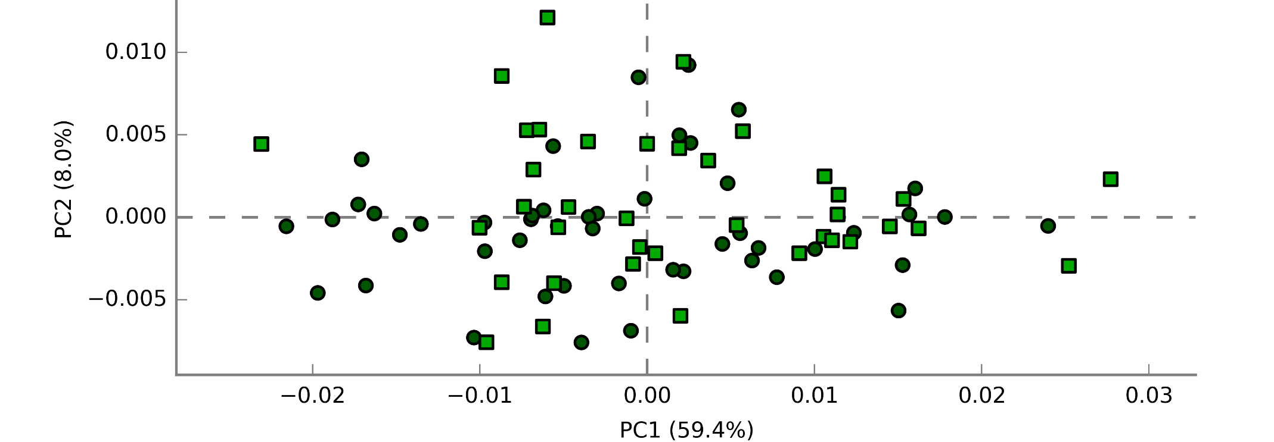
Npas2 Fetal cKO Impairs Functional Microbiome to Light:Dark Cues
Fetal cKO: little to no significant light to dark pathway changes
Neonatal cKO: pathway abundance changes
Wild Type: pathway abundance changes
Notes:
Results from the PICRUST2 predicted functional microbiome analysis, collectively reported a significant difference in pathway abundances amongst all treatments based on ANOVA. ***
These PCA plots visualize clustering based on light and dark timepoints comparisons for each treatment, *** in which the fetal cKO treatment observed little to no differences in the functional microbiome light cycle phase-shifts, and have completely dissociated food income from intake, demonstrating lack of entrainment & adaptability to when Npas2 is deleted in utero , whereas the *** wild type and *** neonatal PCA plots comparison show a clear difference between the light and dark timepoint samples.

Slide 17
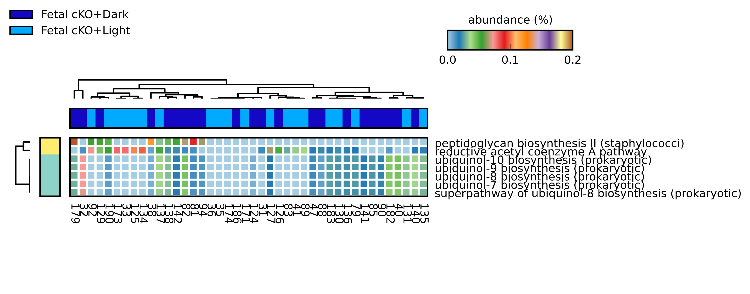


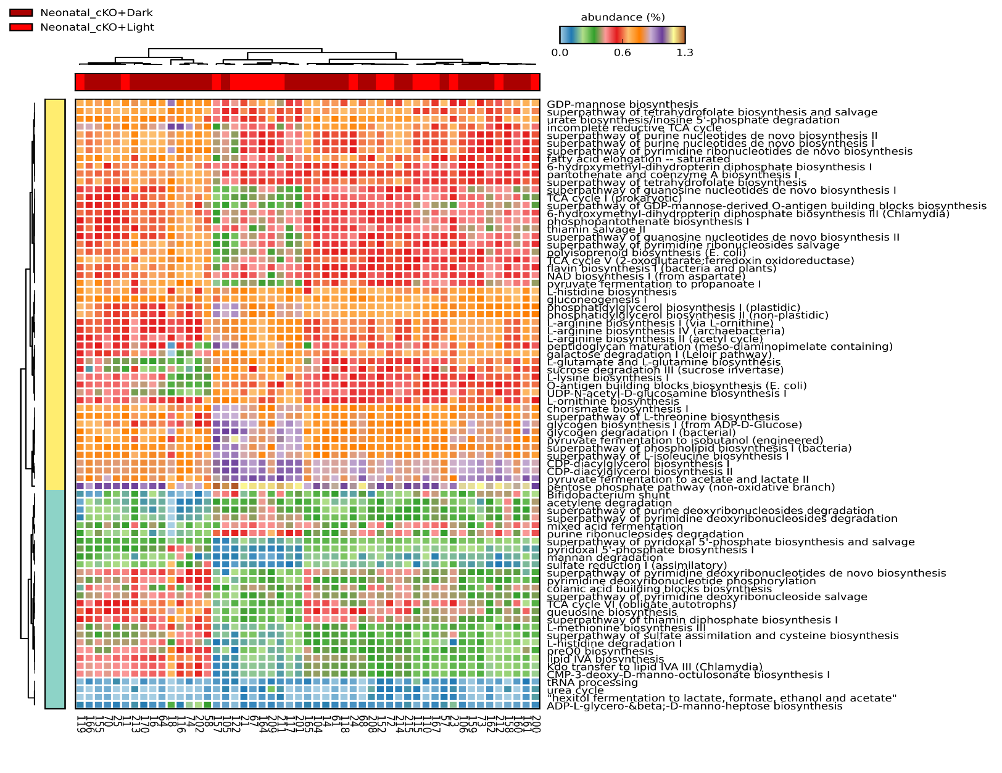
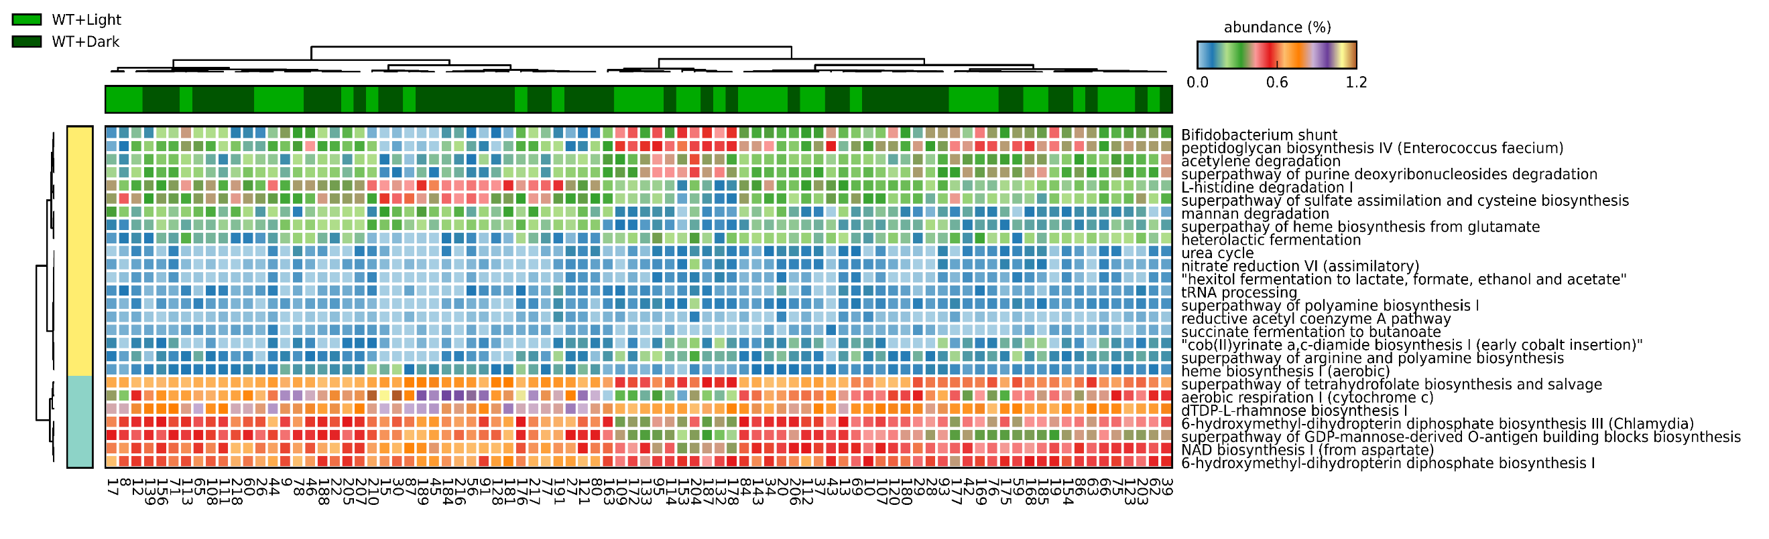
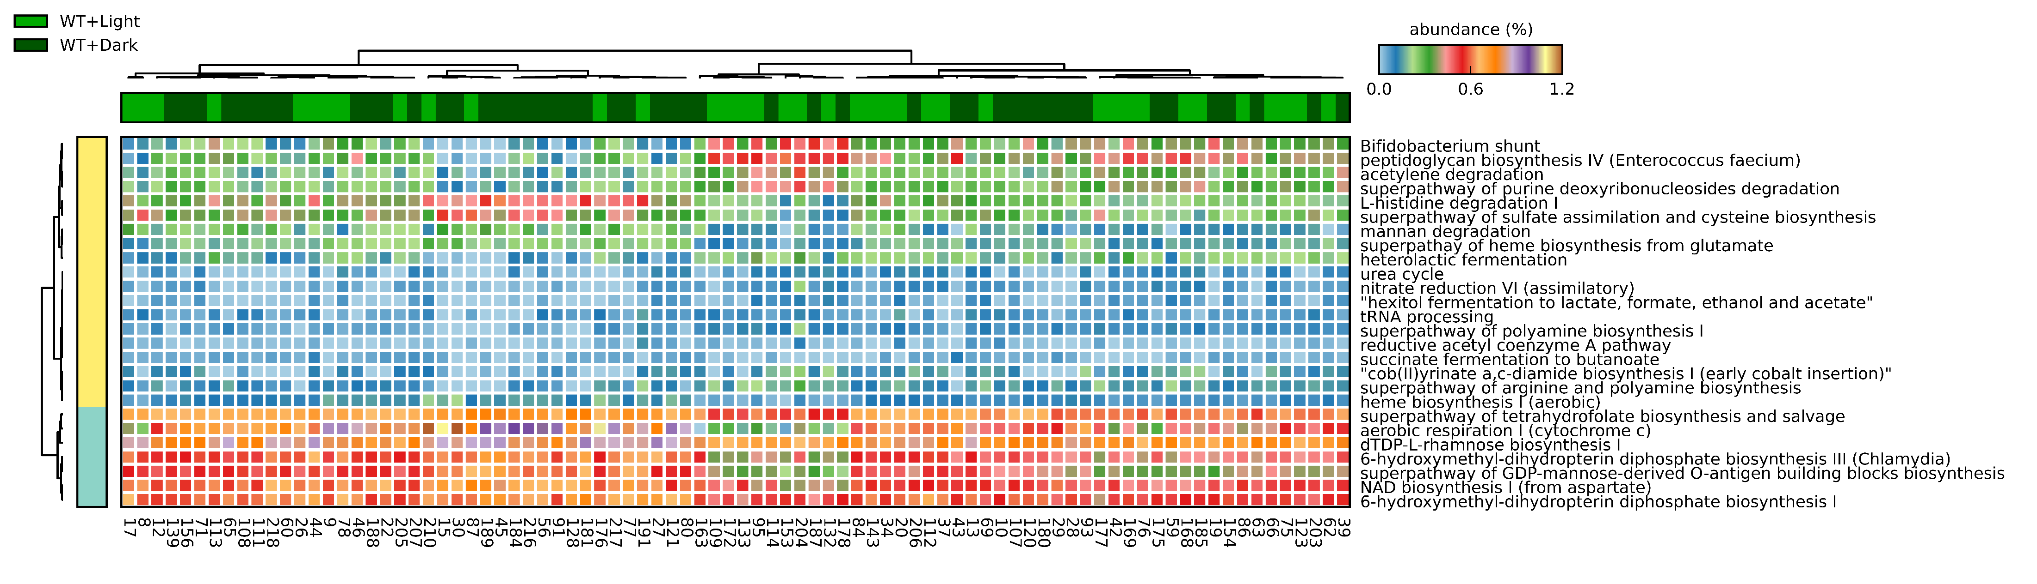
In utero Npas2 Deletion Impairs Functional Microbiome Light:Dark Transitions
Fetal cKO: little to no significant light to dark pathway changes
Neonatal cKO: pathway abundance changes
Wild Type: pathway abundance changes
Notes:
Shown here as a *** heatmap of statistically significant light to dark two way comparisons, you can see that as compared to the wild type treatment which reported 26 pathway abundance differences, ***the fetal cko treatment reported a universal dampening of responses, showing a complete disconnect in changing pathway abundances associated with day and night, *** and the the neonatal cKO mice reported with more than 100 differences in pathway abundances. Taken together, these findings suggest that disruptions to Npas2 hepatic expression significantly alters the functional gut microbiome which may play a role in disrupting metabolic adaptation, and supports the previous results demonstrating lack of entrainment & adaptability when Npas2 is deleted in utero.

